Slide 1




Chickasaw Nation Nutrition Services
Vendor Training

Slide 2


Vendor Training Overview
Overview of programs​
Role of the Nutrition Services vendor​
Minimum variety and stock requirement updates​
Allowable food items/program apps​
Processing an EBT card​
Vendor sanction system​
Vendor complaint and claim procedures​
Final tips and takeaways​
Questions​

Slide 3
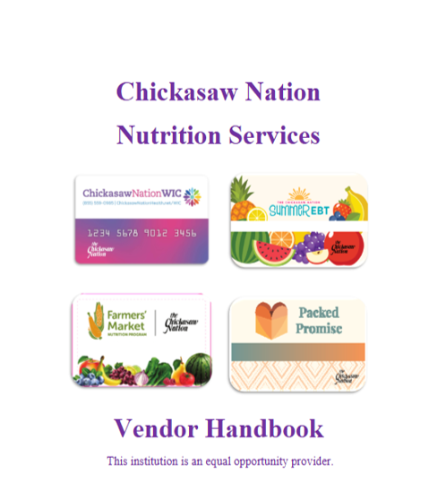
Training Documents
Vendor handbook​
WIC-approved food guide​
Summer EBT-approved food guide​
Card graphics​
Door sticker ​
Complaint forms

Slide 4
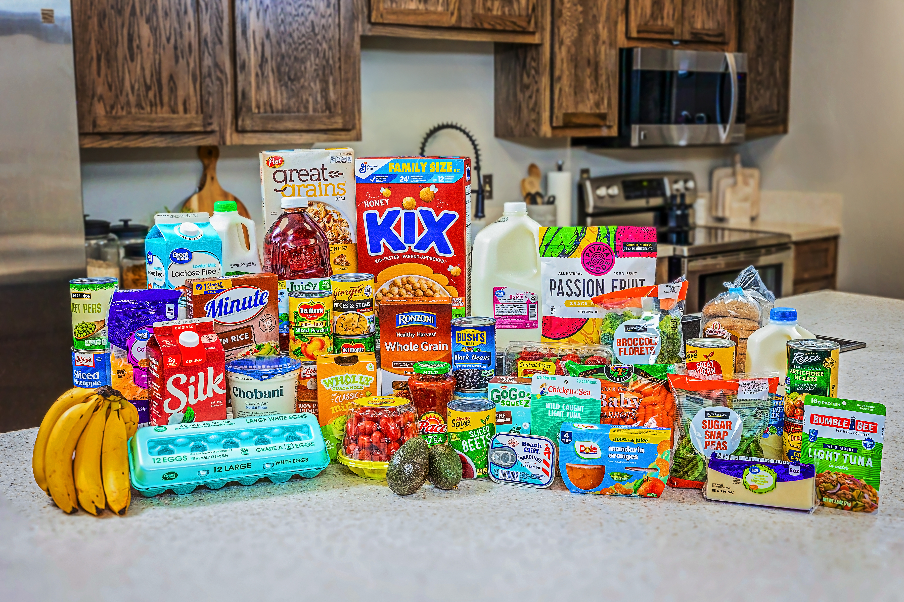
WIC Overview
The Women, Infants and Children (WIC) program serves First American and non-First American families with nutritious foods, breastfeeding support and other educational resources.
Services are designed for pregnant or postpartum women, infants and children up to age 5.
Benefit package varies by participant.
Benefits are year-round.

Slide 5
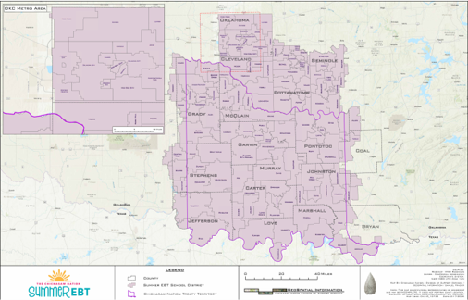
Summer EBT Overview
Federally funded program available to all eligible children,participants do not have to be First American to qualify.
Qualifying children will receive a food benefit package, similar to the WIC child food package.
Benefits are issued once per child per summer and are placed on an EBT card.
Benefits start in May, with new applications processed through August and benefits added as applications are approved.
Participants have 122 days from time of issuance to utilize benefits. Benefits may run through the winter months for families who apply later in the season.
In 2025, the Summer EBT program served 136,245 children overall. The service area expanded to include students in Oklahoma and Cleveland counties, with 86,941 children served just in those counties.

Slide 6

Packed Promise Overview
Innovative supplemental nutrition benefit service offering shelf-stable meal delivery to increase food access, food security and diet quality for Chickasaw children.​
Children must:
  Be between the ages of 4-18
  Have documentation of Chickasaw citizenship
  Be eligible for free or reduced-cost school meals
  Reside in the Chickasaw Nation or 10 counties adjacent or within proximity to the Chickasaw Nation's boundaries, including Atoka, Caddo, Canadian, Cleveland, Comanche, Cotton, Hughes, Pittsburg, Pottawatomie and Seminole to qualify.​
$15 Cash Value Benefit (CVB) can be used at authorized grocery stores. ​
Benefits are year-round

Slide 7
Role of the Nutrition Services Vendor
Provide supplemental foods free of charge and tax-free to participants
Maintain the integrity of food purchase transactions
Exhibit courteous behavior with participants/customers
Assure participants receive full benefit from the program by assisting, identifying and purchasing approved food items
Sign a vendor agreement outlining the standard requirements

Slide 8
EBT Card Processing
All Chickasaw Nation EBT programs should be processed the same.
Chickasaw Nation EBT program cards must be used in a separate transaction, but other forms of payment (SNAP, debit, credit, cash) can be combined with any of the program's transactions.
For questions or shopping issues, contact:​​
Summer EBT (580) 272-1178​​
Summer EBT Vendor Coordinator: Rusty Johnson (580) 967-5398​​
Packed Promise (844) 230-3785​​
Packed Promise Manager: Michael Worcester (580) 235-0504​​
WIC (580) 421-4581​​
WIC Vendor Coordinator:​ Tia Carter (580) 447-4701​​
WICVendor@Chickasaw.net

Slide 9
Minimum Stock Requirements
The Chickasaw Nation Nutrition Services has established​ minimum requirements for the variety and quantity of supplemental foods a vendor​ applicant must stock to be authorized.
  Two (2) different fruits
  Three (3) different vegetables
  At least one (1) authorized whole-grain cereal​

Slide 10
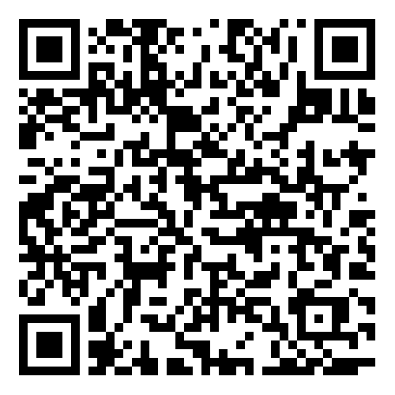
Approved WIC Foods
WIC – Food package varies by age and type of WIC participant
Packed Promise – fruits and vegetables cash value: $15 per child per month​
Summer EBT – WIC foods allowed, the following benefits are issued once per child per year: ​
  Fish: 15 ounces​
  Low-fat or fat-free milk: 3 gallons​
  Cheese: 3 pounds​
  Eggs: 3 dozen​
  Fruits and vegetables cash value: $33
  Whole grains: 48 ounces​
  Whole- grain cereal: 54 ounces​
  Peanut butter or beans: 3 pounds, 3 containers, 16 cans, or a combination of all 3​
  Yogurt: 3 quarts
  https://oklahoma.wicresources.org/approved-food-list-chickasaw-nation/

Slide 11
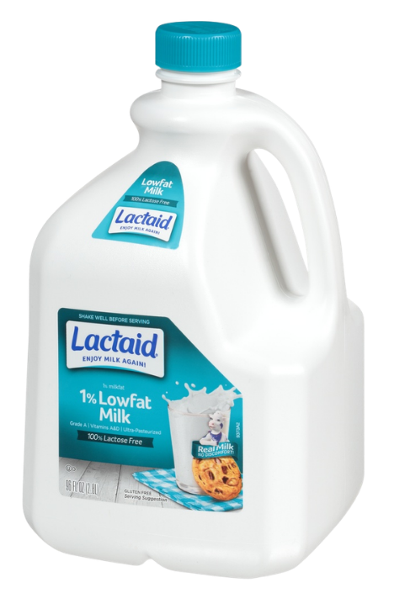


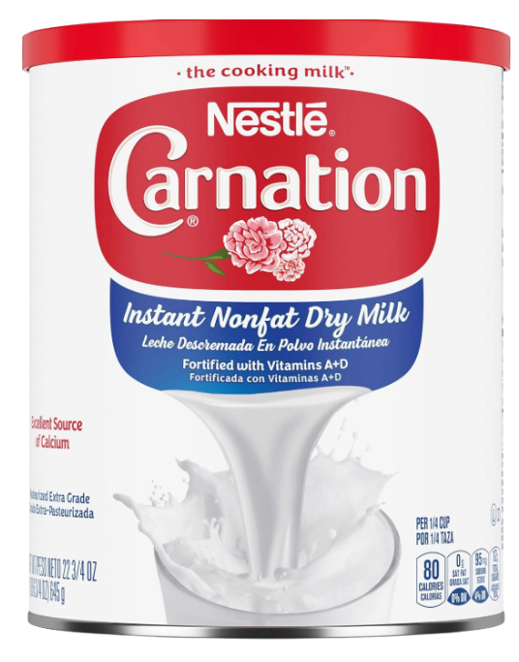
Milk Substitutions
WIC and Summer EBT

Slide 12
Vendor Changes
If ownership changes, the vendor agreement becomes void.
Notify Chickasaw Nation Nutrition Services of the change in writing.
The new store owner may apply to become a nutrition services program authorized vendor, but eWIC cannot be accepted until the new store owner’s vendor authorization has been granted by Chickasaw Nation Nutrition Services.
Vendors may voluntarily end their agreement at any time by providing 30 days written notice.
  At the end of this 30-day period, eWIC benefits may no longer be accepted by the vendor.
  Chickasaw Nation Nutrition Services will not honor reimbursement claims for eWIC transactions conducted after that 30-day period.

Slide 13
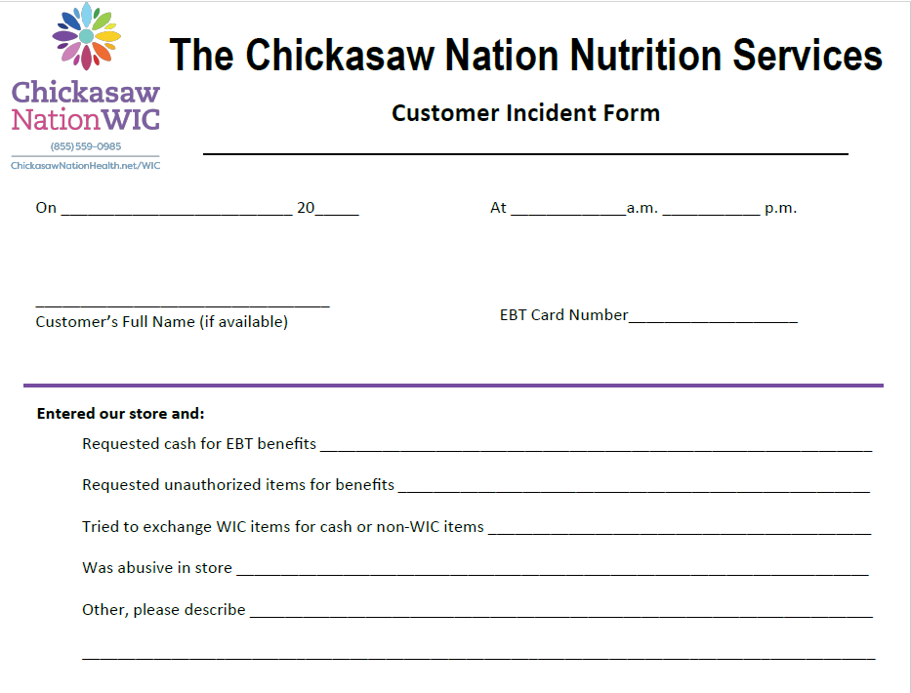
Customer Incident Form

Slide 14
Vendor Sanctions
The Chickasaw Nation Nutrition Services program investigates all alleged violations of the federal and state laws and rules.
The Chickasaw Nation Nutrition Services program montors the operations of all Nutrition Services retail food vendors to ensure compliance with federal and state laws and rules governing the Nutrition Services program.
Refer to your Nutrition Services Vendor Handbook for full desciption of sanctions.

Slide 15


Slide 16
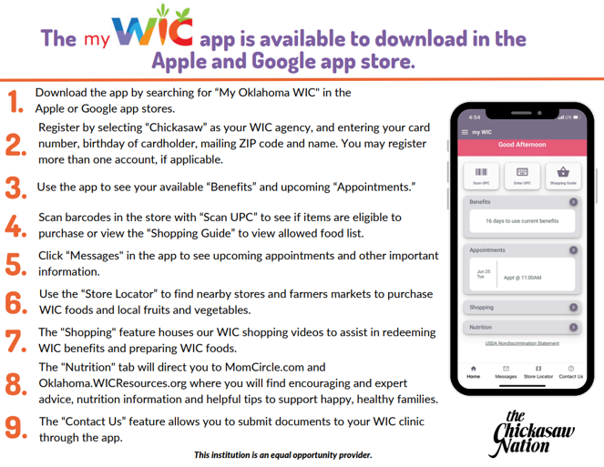


Program Shopping Apps
Apple App Store
Google Play Store

Slide 17
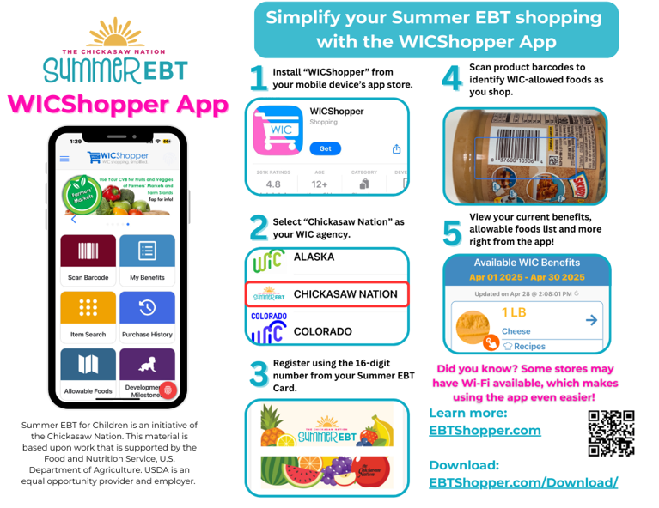

Slide 18
Vendor Tips
Provide vendor handbook to store managers​
Download the myWIC app or WICShopper app to access the allowable foods guide
Provide a copy of allowable foods guide at each cash register​​
Display door stickers to clearly mark and identify store as an approved Chickasaw Nation EBT vendor​​
Maintain frequent communication with POS provider​​
Ensure daily APL upload ​
Alert Chickasaw Nation Nutrition Services of any POS technical issues, transaction issues or APL concerns

Slide 19
Questions?

Slide 20
Follow us on Facebook and Instagram @ChickasawNationWIC
Contact Information
SEBT Vendor Coordinator
Rusty Johnson
(580) 967-5398​​
Rusty.Johnson@Chickasaw.net
WIC Vendor Coordinator
Tia Carter
(580) 447-4701
Tia.Ross@Chickasaw.net
WICVendor@Chickasaw.net

